Slide 1
NINPAA 2021
NINPAA 2021

Slide 2
GENERAL BODY 2020

Slide 3
GLIMPSE OF NP LEADERS ACTIVE IN INDIAN PROGRAMS

Slide 4
2021NEW OFFICERS INSTALLATION CEREMONY

Slide 5
NINPAA VISION
The vision of the National Indian Nurse Practitioners Association of America is to promote professional excellence, career advancement, quality healthcare through leadership, education, and advocacy by Nurse Practitioners.

Slide 6
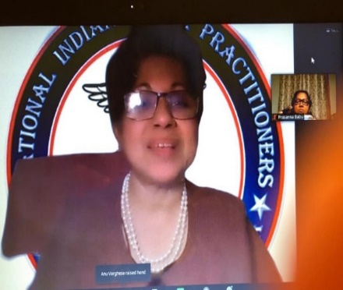
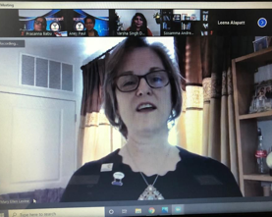
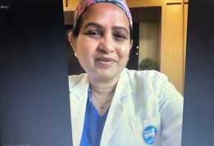
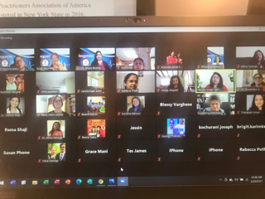
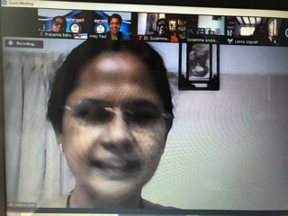
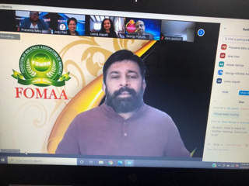
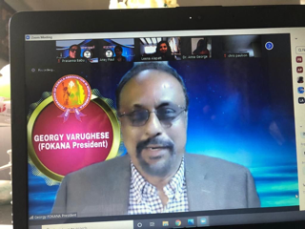
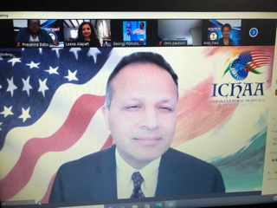
INSTALLATION CEREMONY KEYNOTE SPEAKER &GUESTS

Slide 7
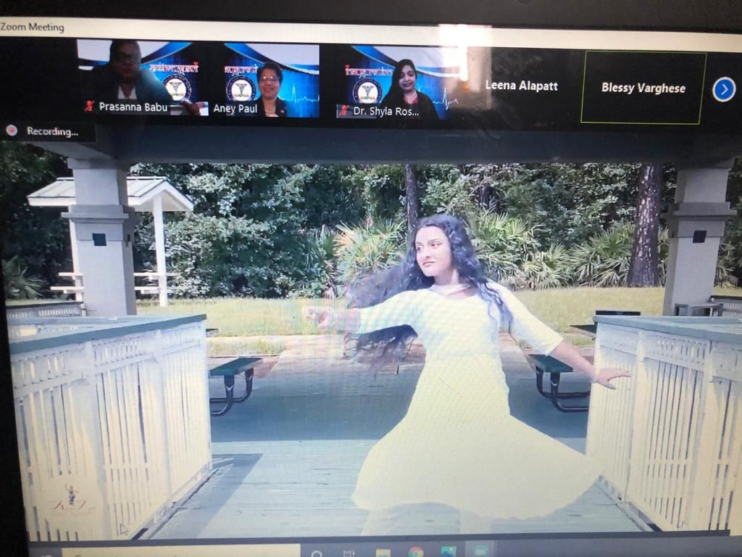
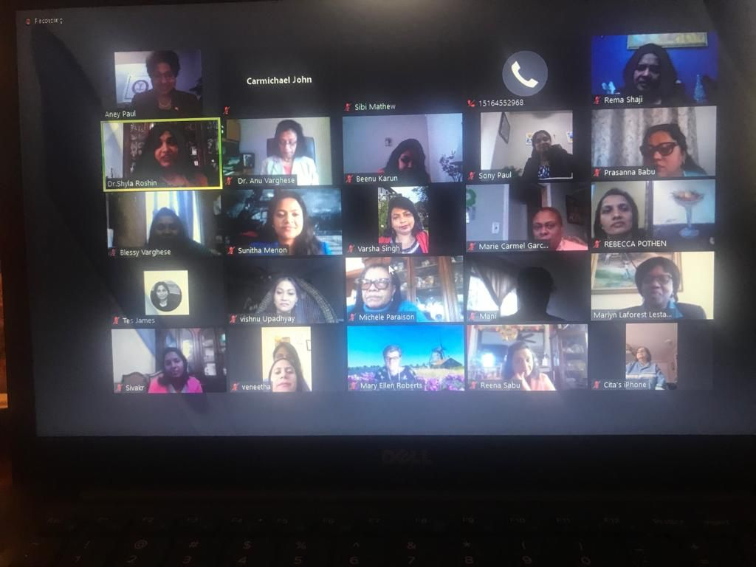
INSTALLATION CEREMONY AUDIENCE &PERFORMERS

Slide 8
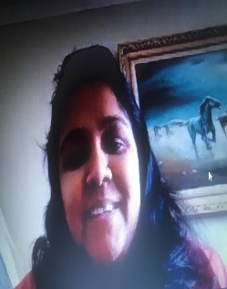
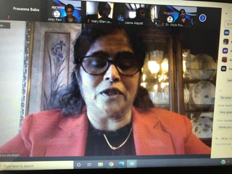
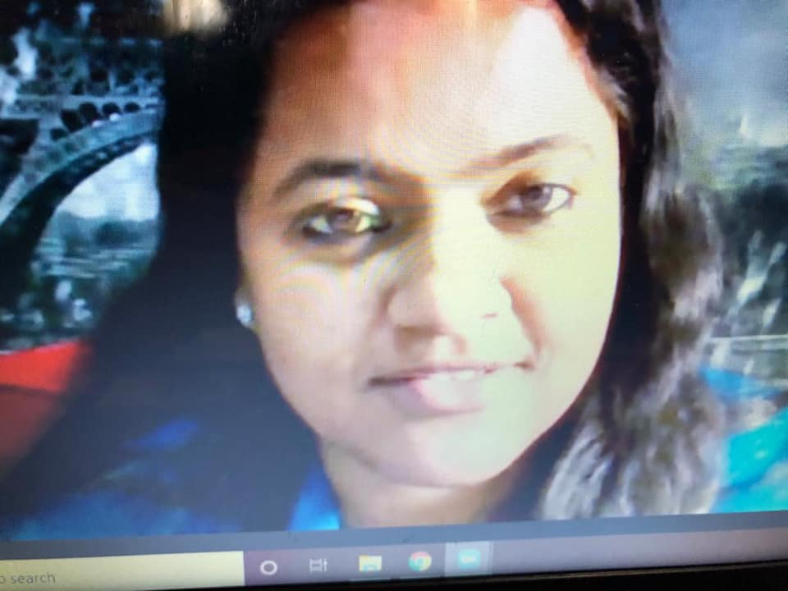
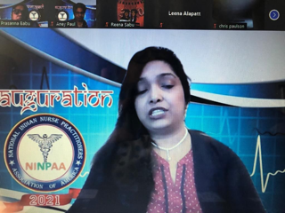
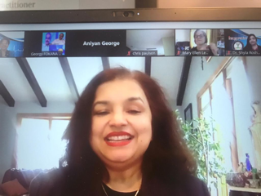
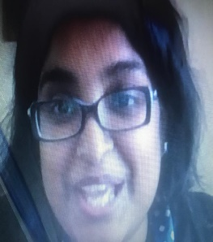
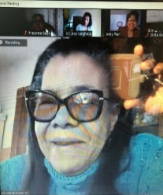
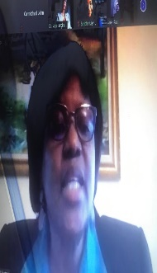
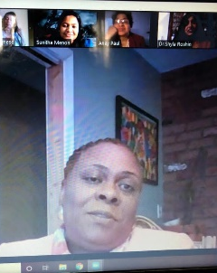
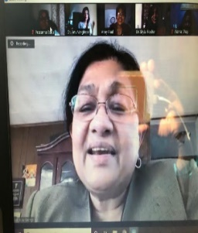
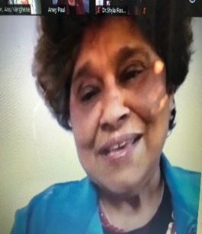
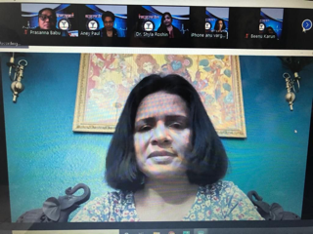
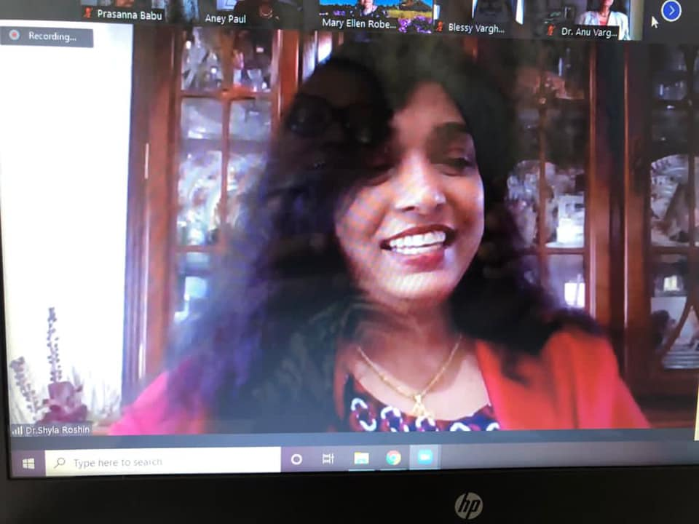
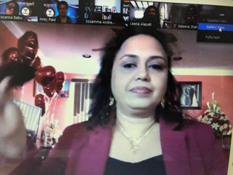
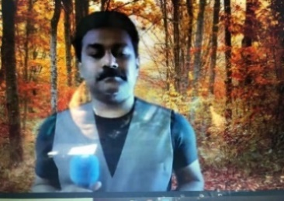
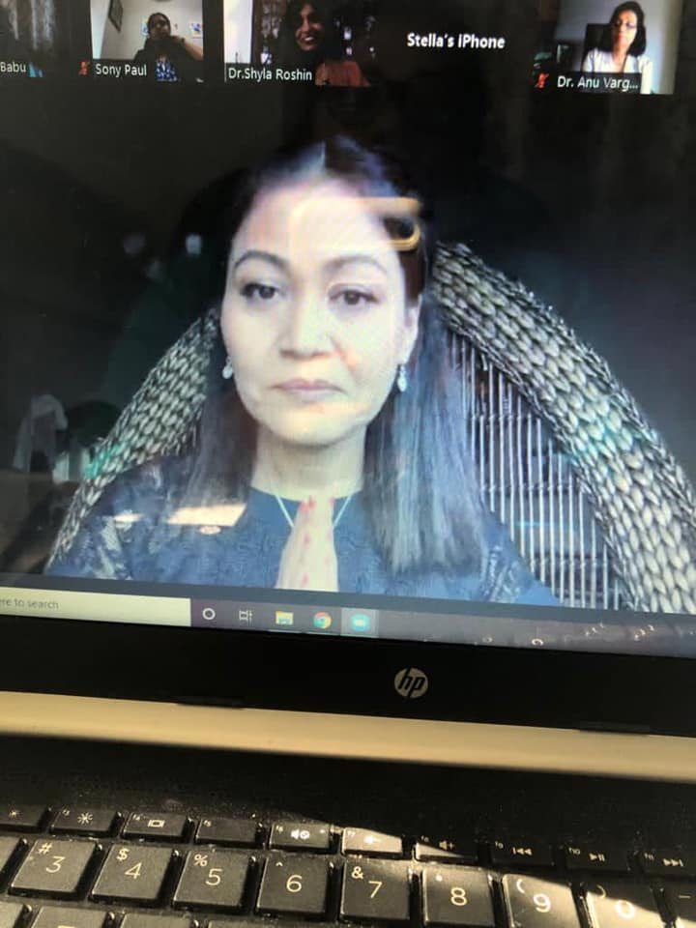
MEMBERS IN ACTION

Slide 9
INSTALALTION CEREMONY AUDIENCE

Slide 10
EXECUTIVE BOARD

Slide 11
COMMITTEE MEMBERS

Slide 12
COMMITTEE MEMBERS

Slide 13
COMMITTEE MEMBERS

Slide 14
COMMITTEE MEMBERS

Slide 15
DIRECTORS AT LARGE

Slide 16
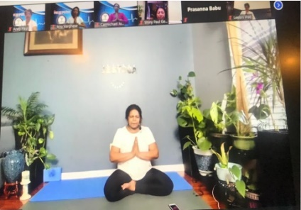
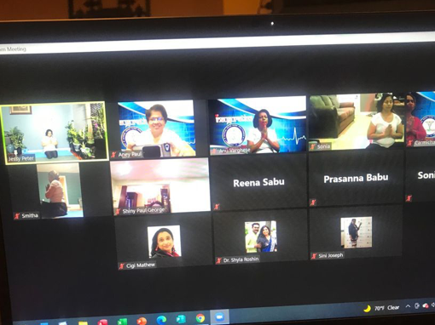
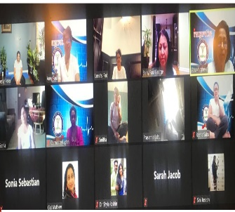
YOGA DAY: TAKE CARE OF YOURSELF

Slide 17
COVID 19 INDIA RELIEF FUNDRAISING
NINPAA reach out its members to put their hands together, stretch helping hands for the struggling home country.

Slide 18
SIMINI FUNDRAISING

Slide 19
EDUCATIONAL PRESENTATION
COVID VACCINE DEVELOPMENT AND ROLL OUT
By Dr Lija Gireesh, DNP, FNP-BC, NEA-BC, COHN-S

Slide 20
EDUCATIONAL PRESENTATIONS
Provider Order for Life Sustaining Treatment POLST) By Dr. Rose Antony, DNP, MSN, FNP

Slide 21
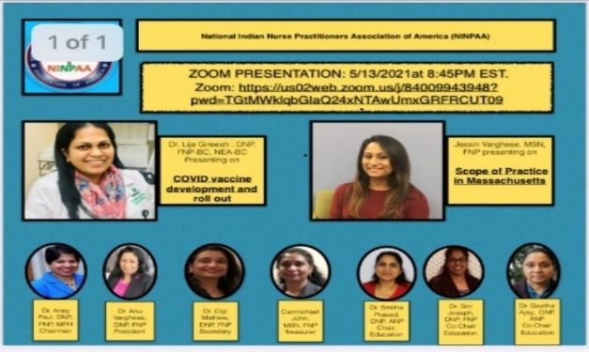
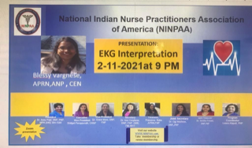
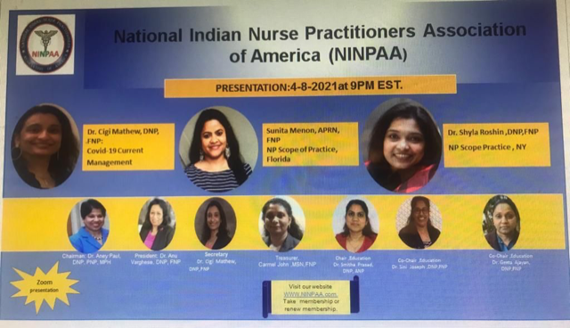
EDUCATIONAL PRESENTATIONS

Slide 22
EDUCATIONAL PRESENTATIONS

Slide 23
HANDING OVER &PANNEL DISCUSSON

Slide 24
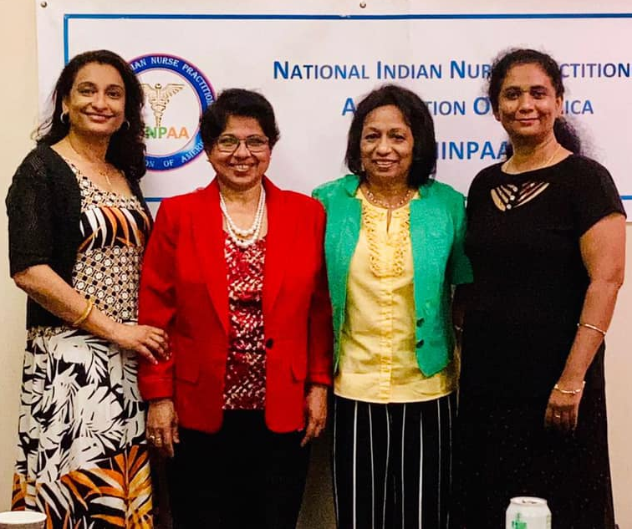
HANDING OVER

Slide 25
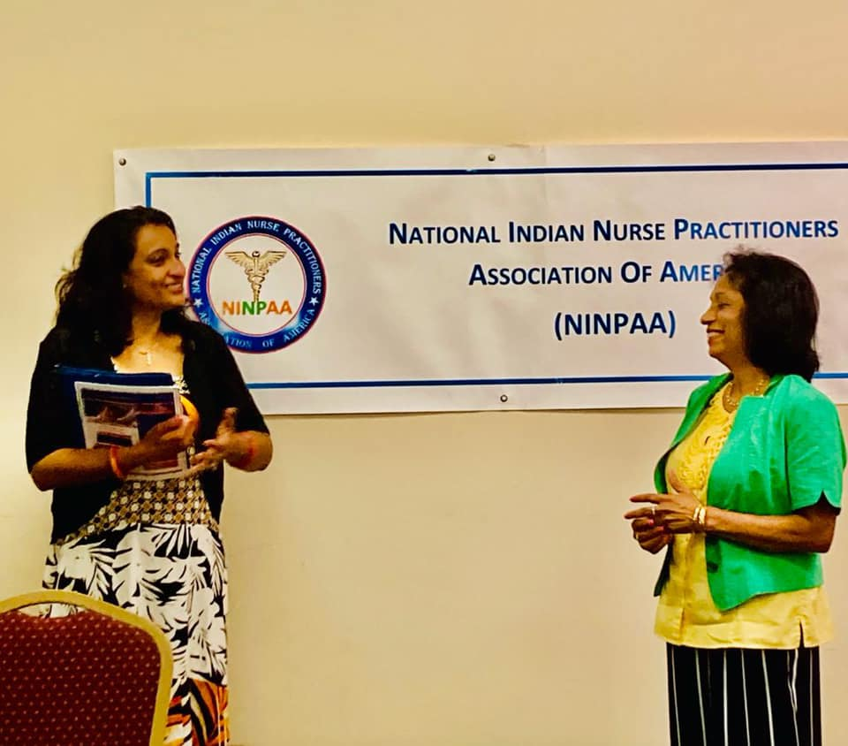
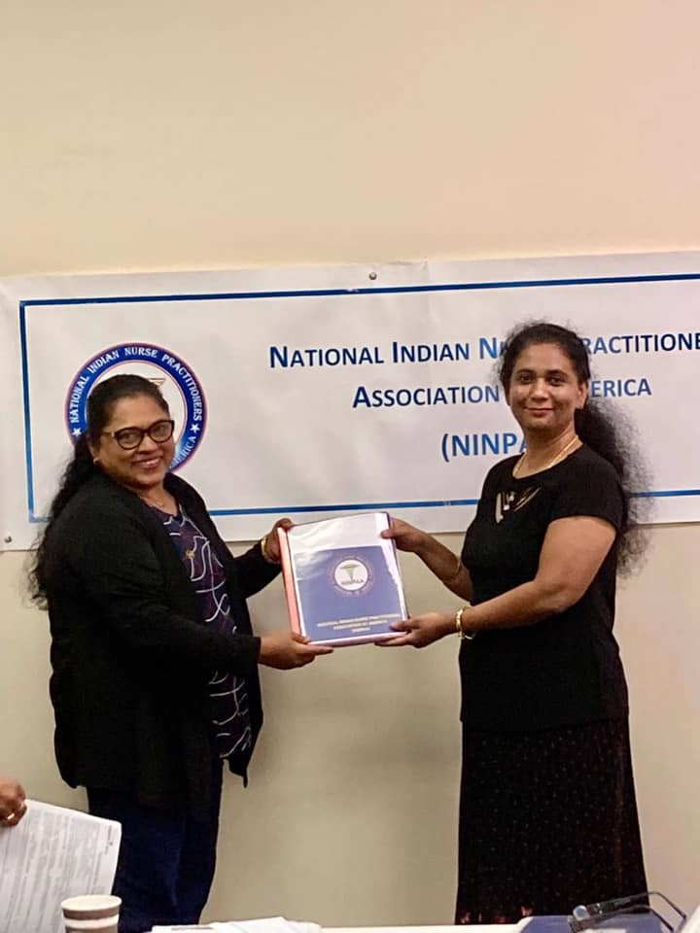
HANDING OVER IN CT

Slide 26
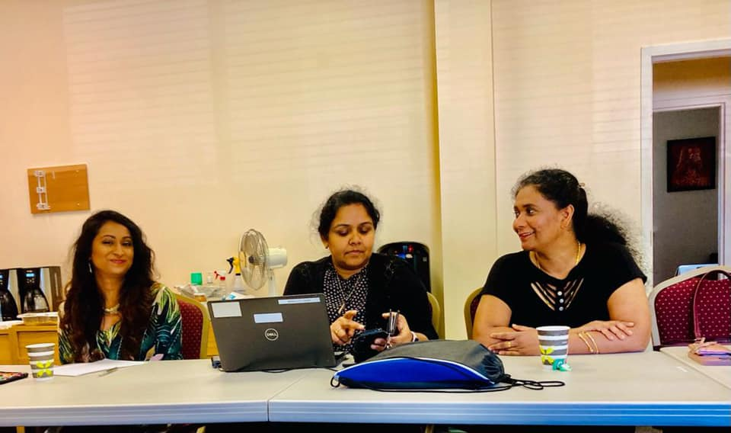
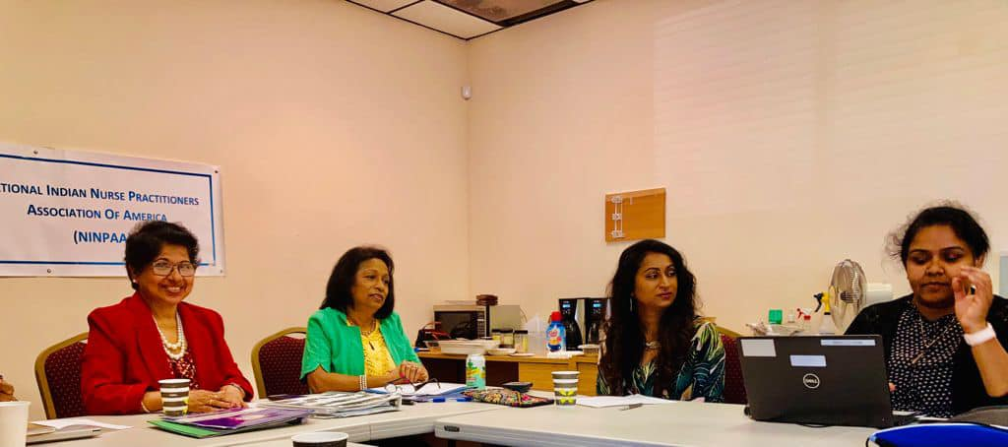
HANDING OVER IN CT

Slide 27
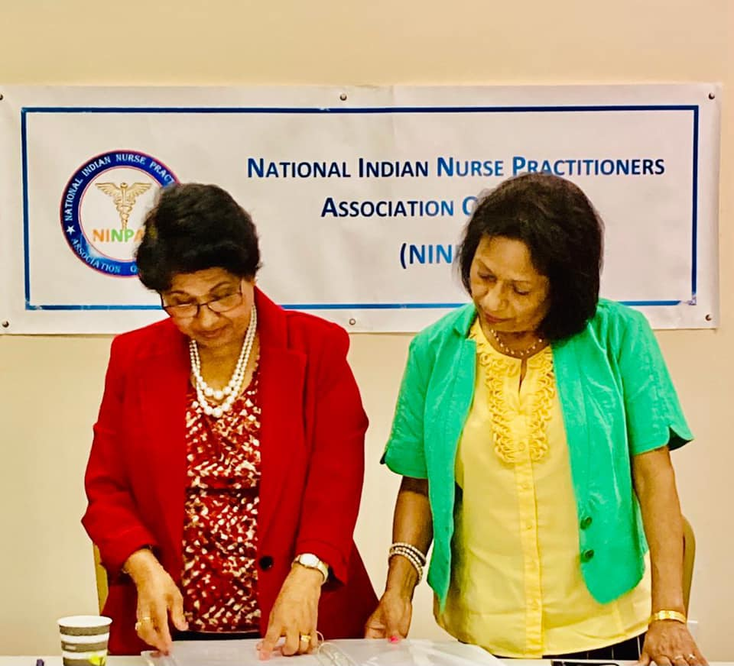
HANDING OVER IN CT

Slide 28
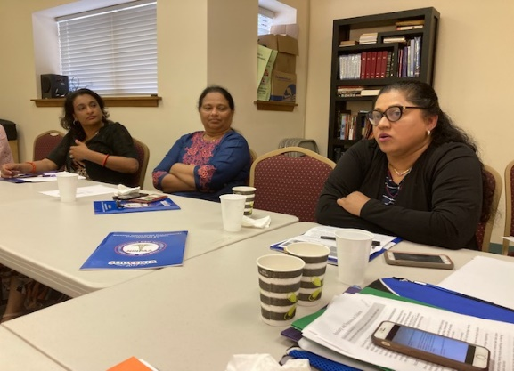
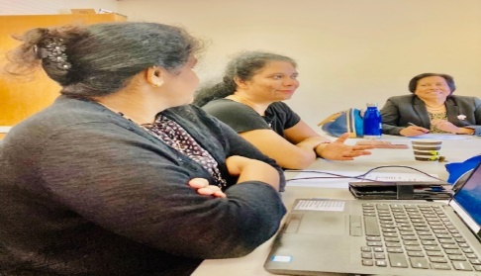
PANNEL DISCUSSION IN CT

Slide 29
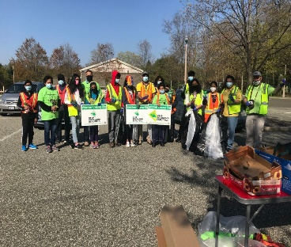
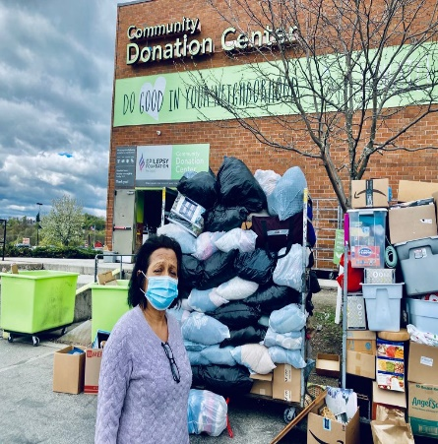
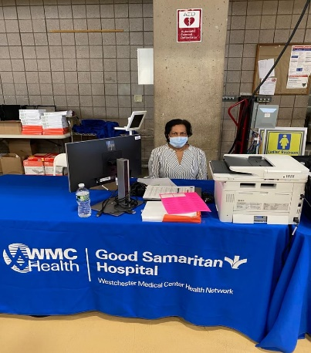
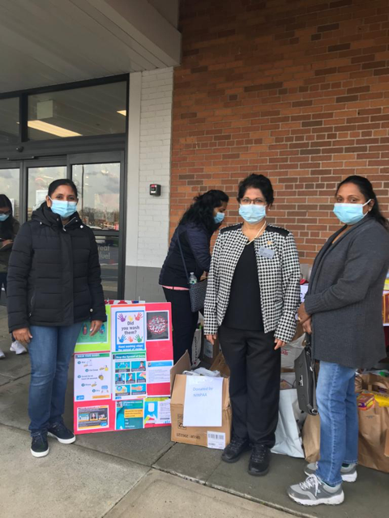
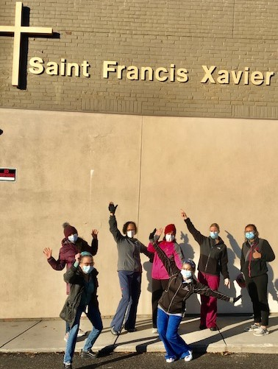
MEMBERS VOLUNTEERRING

Slide 30
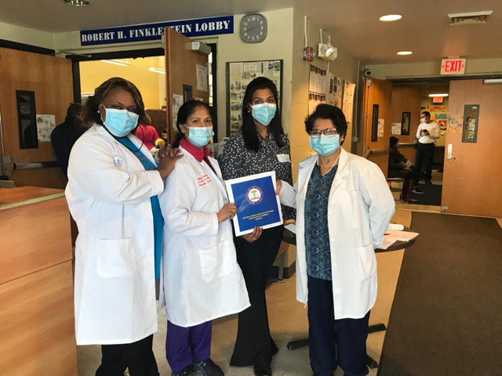
MEMBERS IN COMMUNITY SERVICE

Slide 31
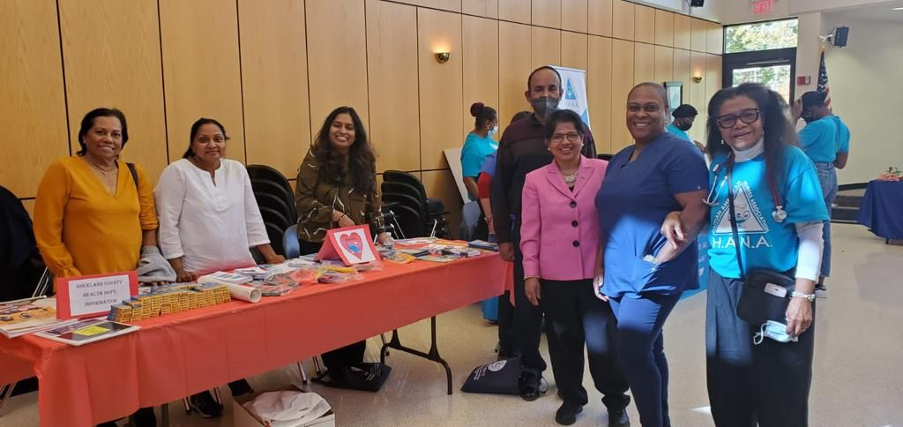
COMMUNITY SERVICE

Slide 32
COMMUNITY SERVICE

Slide 33
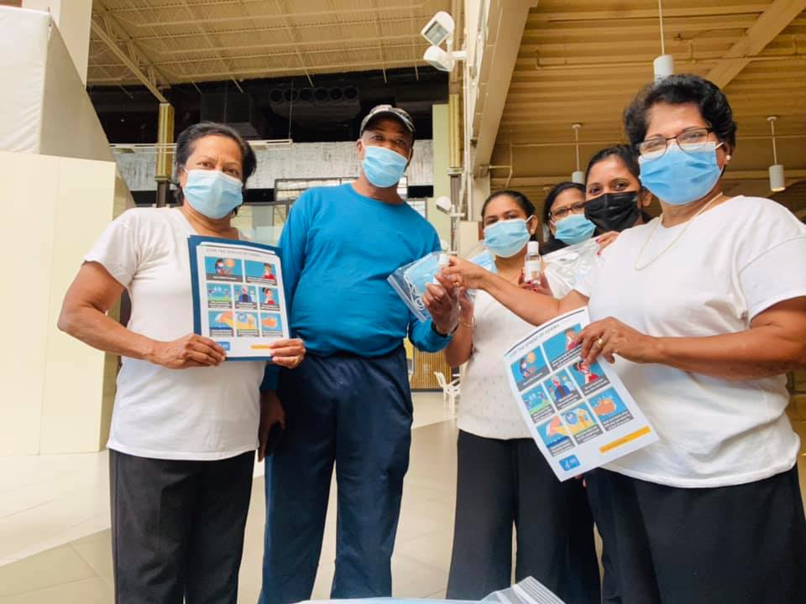
COMMUNITY SERVICE

Slide 34
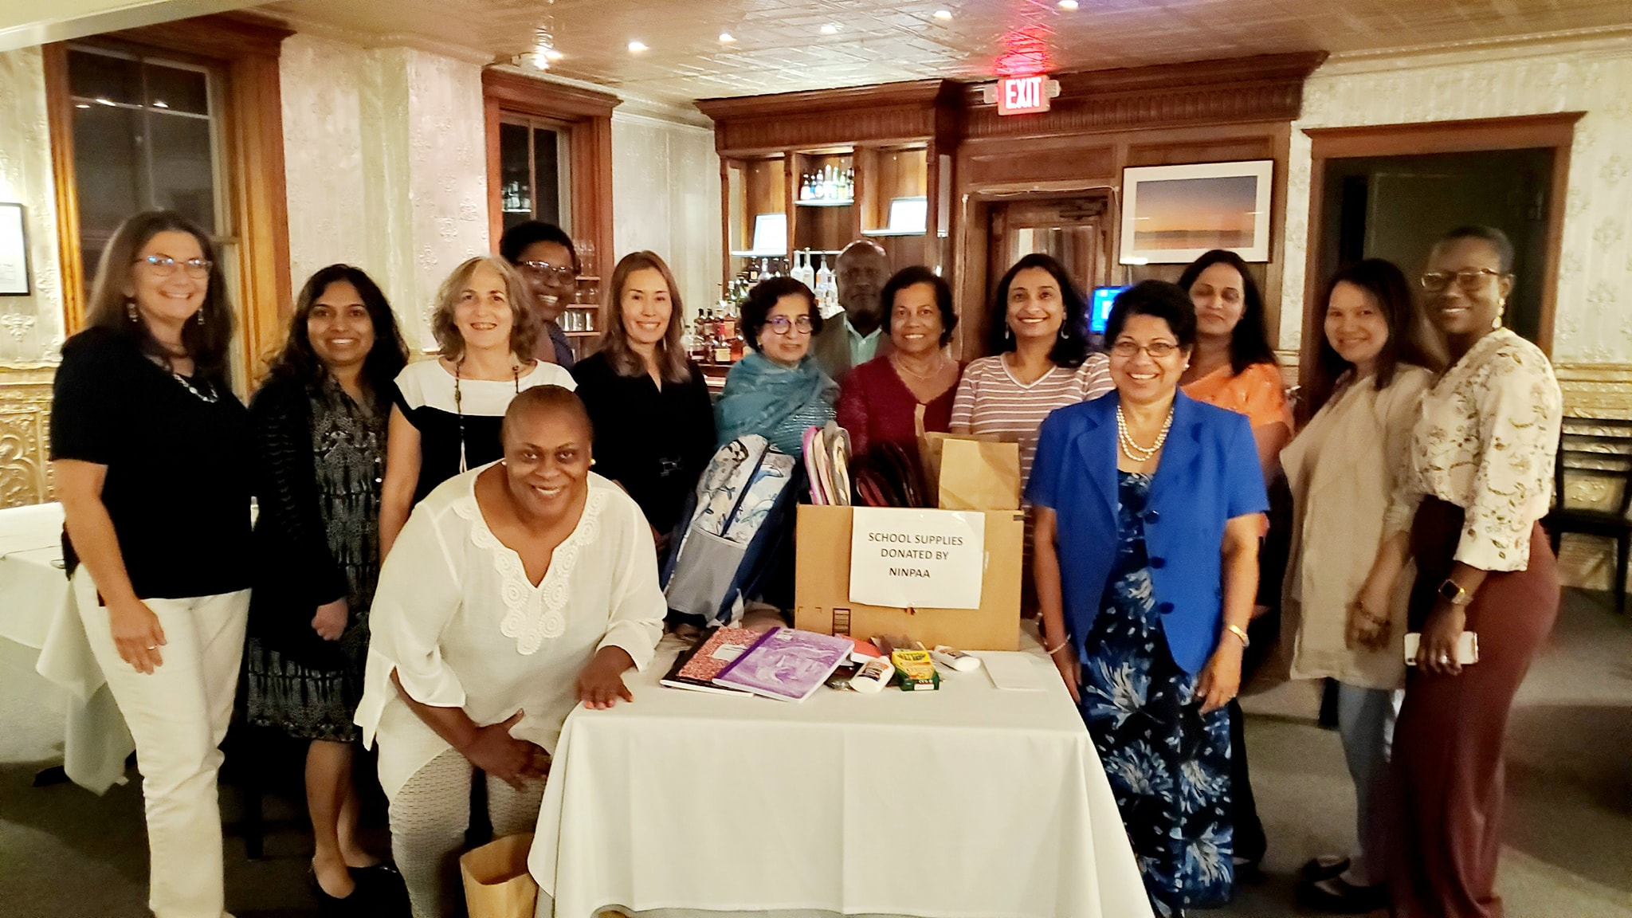
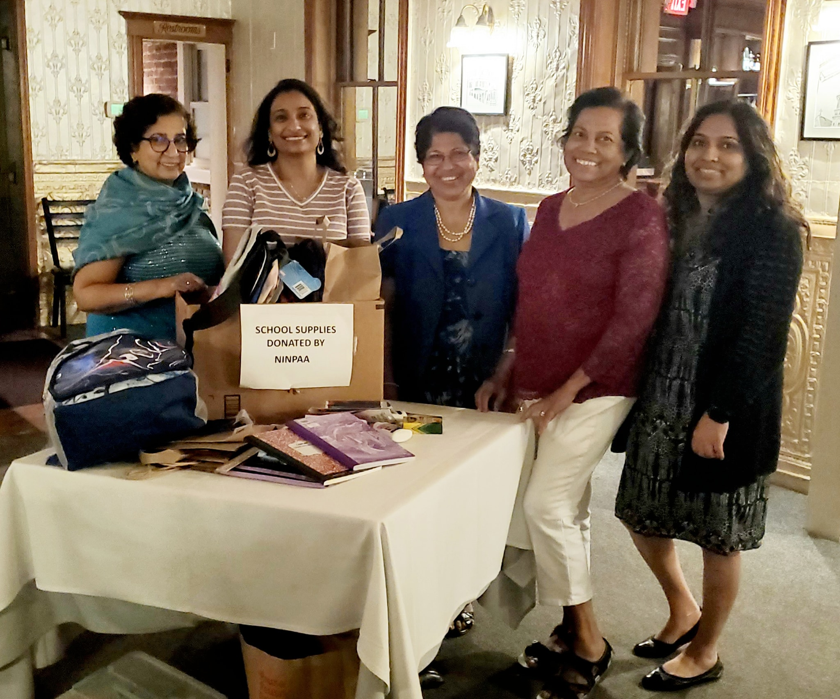
COMMUNITY SERVICE

Slide 35
COMMUNITY SERVICE

Slide 36
EARTH DAY CELEBRATIONS

Slide 37
GLIMPSE OF AWARDS RECEIVED by MEMBERS

Slide 38
MEMBERS RECEIVED AWARDS

Slide 39
MEMBERS RECEIVED AWARDS

Slide 40
HEALTHY WALKING

Slide 41
NINPAA ACTIVITIES

Slide 42
COVID -19 ANNIVERSARY

Slide 43
2020 NP WEEK CELEBRATION

Slide 44
NINPAA SCHOLARSHIPS

Slide 45
MEMBERS NETWORKING

Slide 46
NINPAA FLORIDA MET

Slide 47
NINPAA DALLAS MET

Slide 48
NIPAA MEMBERS COLLAGE

Slide 49
3RD NATIONAL EDUCATIONAL SEMINAR

Slide 50
EDUCATIONAL SEMINAR

Slide 51
EDUCATIONAL SEMINAR

Slide 52
EDUCATIONAL SEMINAR SPEAKERS

Slide 53
EDUCATIONAL SEMINAR

Slide 54
2021 NP WEEK CELEBRATION

Slide 55
NINPAA NP WEEK CELEBRATION 2021

Slide 56
NP WEEK CELEBRATIONS MEMBERS AT THEIR WORK

Slide 57
GENERAL BODY AND CHRISTMAS CELEBRATIONS 2021

Slide 58
GENERAL BODY AND CHRISTMAS CELEBRATIONS 2021

Slide 59
MERRY CHRISTMAS AND HAPPY NEW YEAR
NINPAA WISHING YOU
A MERRY CHRISTMAS AND
A HAPPY NEW YEAR TO ALL !
BY Dr. Anu Varghese
NINPAA President

